Slide 1
Activity Diagram

Slide 2
AD is a flowchart to represent the flow of control among the activities in system.
Shows the message from one activity to another, which the activity can be
Sequential
Branched or concurrent

Slide 3




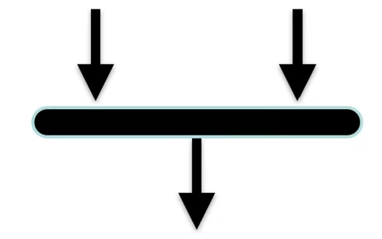
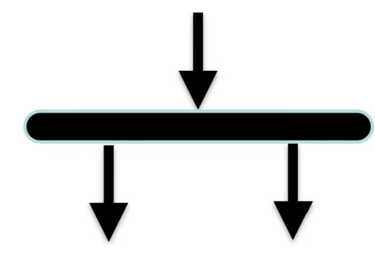
Notations
Start Node
Final Activity Node
Activity
Control Flow
Join Node
Fork Node

Slide 4
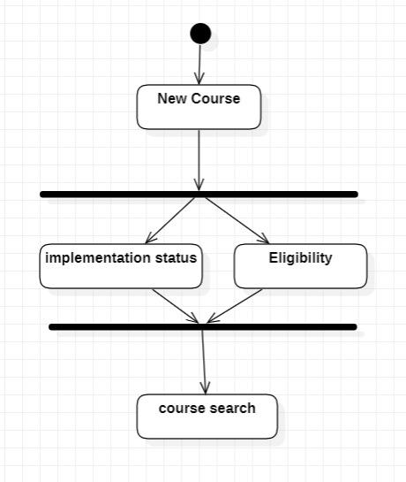
Course Registration (Example)
Fork Node
Joint Node

Slide 5
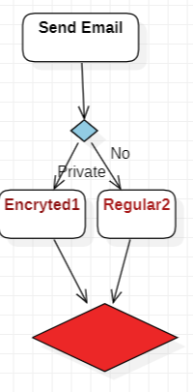
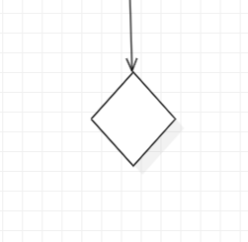
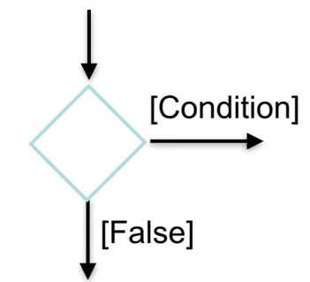
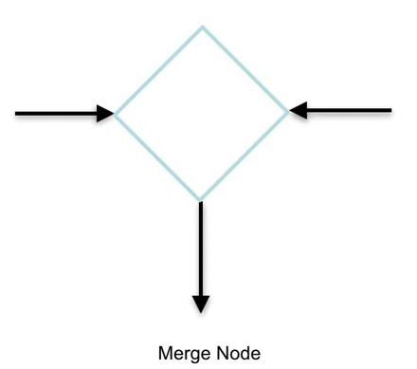
Notations
Decision
Condition
Merge Node
Two activies are merged with condition and only one activity flows forward

Slide 6
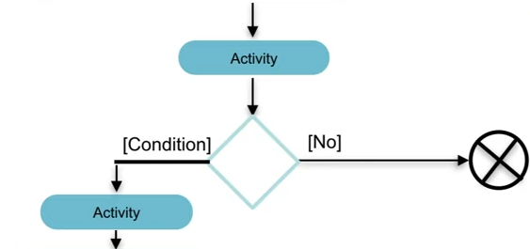
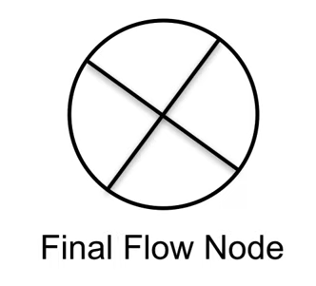
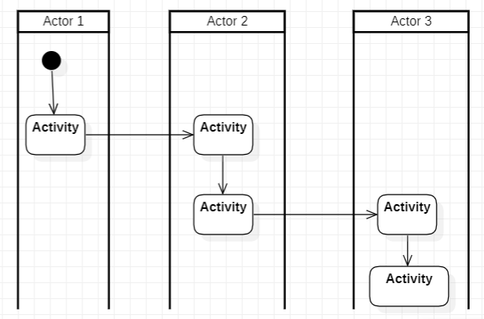
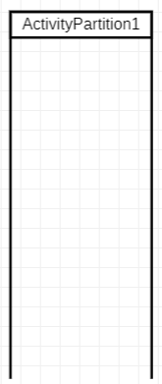
Notation
Final Node
Partition / Swim lanes

Slide 7
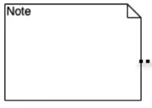


Notation
Note, add a relevant comments to elements
Sending Signal
Signal Receipt

Slide 8
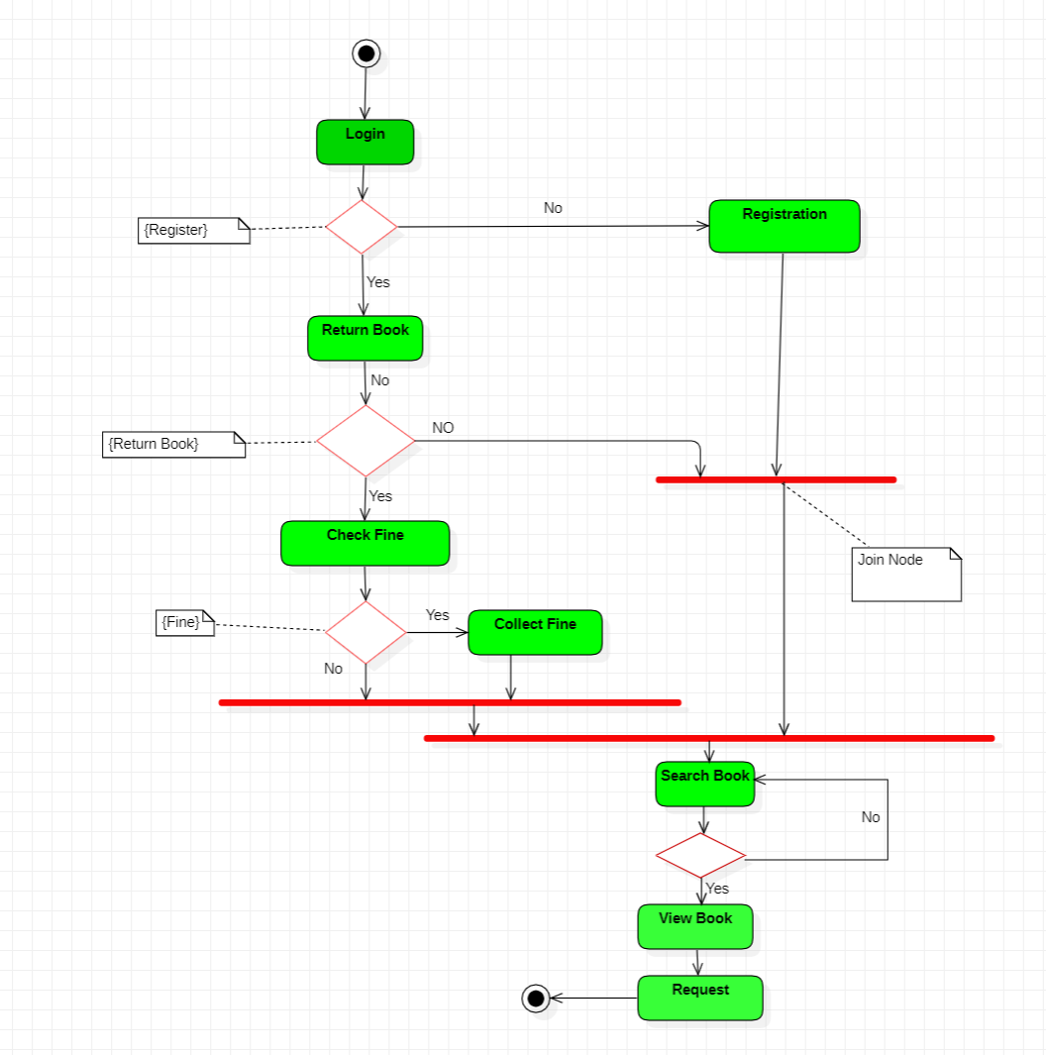
Example

Slide 9
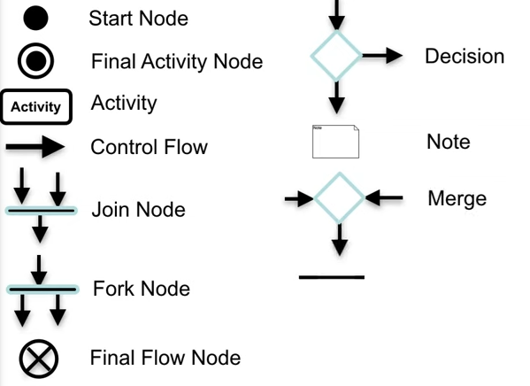
Summary

Slide 10
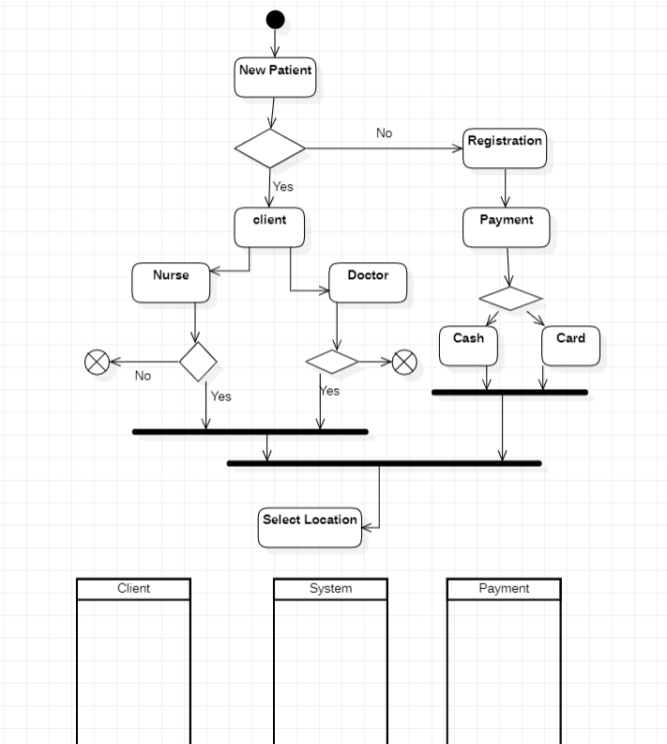
Exercise

